Slide 1
Federal Transit Administration (FTA)
Section 5310
2026 Call for Projects
Informational Meeting
August 5, 2026

Slide 2
Welcome Introductions
STA Staff
  Emilio Bustos, Assistant Transit Planner
    ebustos@spokanetransit.com
  Tara Limon, Principal Transit Planner
    tlimon@spokanetransit.com
Meeting attendees
  When called upon, please unmute, share your name and your agency

Slide 3
Meeting Agenda
FTA Term Refresher
Program Introduction
Section 5310 Program Overview
Call for Projects timeline
2026 Funding Available
Timeline
5310 Program Requirements
Regional Plan Requirements
Eligible projects
Applications Requirements
Procurement Requirements
Project Scoring Criteria
Subrecipient Requirements
5310 Project Examples
Questions

Slide 4
Terms Used in This Presentation
Federal Term | Term Used in This Presentation
Traditional Projects | Capital Projects
Other Projects | Operating Projects
Federal Share | Federal Match
Local Share | Local Match
Designated Recipient | STA
Subrecipient | Applicant / Awarded Agency

Slide 5
Section 5310 Program Overview
FTA provides annual Section 5310 funding for projects serving seniors and individuals with disabilities
STA is the designated recipient responsible for administering the Spokane region’s Section 5310 program
Eligible organizations compete for funding through an annual Call for Projects
Non-profits and other agencies apply for funding for projects that provide
STA awards funds, monitors project performance, and ensures compliance with federal requirements
STA Call for Projects
STA Funding Recommendation
Board Approval
Agreement Execution & Oversight

Slide 6
2026 Section 5310 Call for Projects Timeline
Date | Action
August 3, 2026 | Issue Call for Projects via STA and SRTC websites, newspaper, and Section 5310 listserv
August 4, 2026 | Begin scheduling a required preliminary meeting to review your Section 5310 application
August 5, 2026 | Informational meeting for interested applicants
August 25, 2026 | Preliminary proposals due
September 28, 2026 | Final project applications due
October-November 2026 | Evaluation and ranking of projects
December 2, 2026 | Planning and Development Committee recommends project awards
December 17, 2026 | STA Board action on recommended project applications
2027 | Finalize and execute subrecipient agreements

Slide 7
2026 Total Section 5310 Funding Available
Funding Source | Amount Available | Capital | Operating
FY 2026 Section 5310 Federal Funds | $721,825 | $397,004 | $324,821
STA Local Match* | $252,188 | $24,813 | $227,375
Total Funding Available | $974,013 | $421,817 | $552,196
* The allocation of $252,188 in STA local funds is subject to project evaluation, ranking, and Planning & Development Committee recommendation, and STA Board approval.

Slide 8
What is new this year
Updated Materials | Update Description
Section 5310 Program Management Plan (PMP) | STA updated the PMP to reflect the latest FTA guidance, and requirements. Applicant materials (excluding the risk assessment) received minor updates.
Risk Assessment | STA staff will fill out the risk assessment with the subrecipient during the preliminary virtual meeting
Monitoring Review | Monitoring review results will be used to reassess risk, which may impact monitoring schedule and future funding recommendation
15% De Minimis | Eligible projects may elect to charge a de minimis rate of up to 15%
Meeting with Emilio | All applicants must meet with Emilio prior to submission of your preliminary proposal.

Slide 9
FTA Section 5310 Requirements
Projects must be identified in the Spokane Regional Transportation Council Human Services Coordinated Transportation Plan (HSTP)
Projects must be targeted for seniors and people with disabilities
Projects must begin or end in the Spokane urbanized area
Must have measurable benefit
Local governments/municipal corporations must be approved by the State of Washington to provide human services transportation

Slide 10
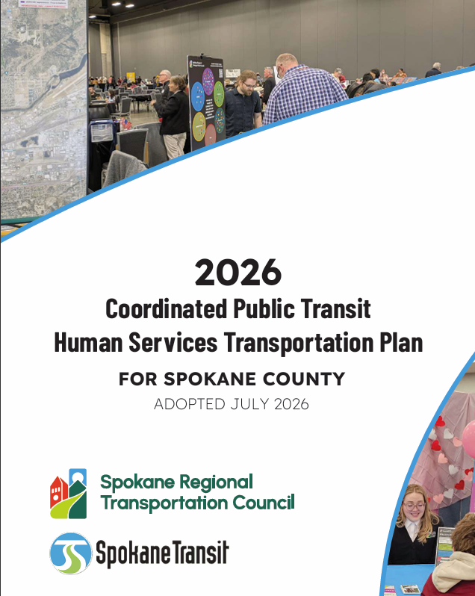
Spokane County Public Transit-Human Services Transportation Plan (HSTP)
All Section 5310 projects must be identified in the HSTP
Spokane Transit and Spokane Regional Transportation Council (SRTC) are involved in the planning process to implement the HSTP
The HSTP is required by state and federal agencies to develop regional strategies to
  Enhance transportation access
  Minimize duplication of services
  Implement the most cost-effective transportation services using available resources

Slide 11
FTA Section 5310 Capital Projects
A minimum of 55% of the federal funds must be awarded to capital projects
FTA standard operating match: 80% local*
Eligible projects include:
  Purchase of ADA vehicles
  ADA-related capital improvements
  Mobility management coordination
  Complimentary Paratransit Service
*Per STA Board approval for the 2026 Call for Projects, capital projects will be subject to a reduced local match requirement of 15% subrecipient local match based on Board of Director’s recommended funding distribution and project ranking.

Slide 12
FTA Section 5310 Operating Projects
Up to 45% of the federal funds may be awarded to operating projects
FTA standard operating match: 50% local*
Eligible projects include:
  Providing alternatives to public transportation
  Improving access to fixed-route services
  Exceeding the requirements of paratransit services
*Per STA Board approval for the 2026 Call for Projects, operating projects will be subject to a reduced local match requirement of 15% subrecipient local match based on Board of Director’s recommended funding distribution and project ranking.

Slide 13
Preliminary Proposal Requirements
  Preliminary Application
  Applicant Contact Information
  Project Cost
  Project Information
  Risk Assessment
    New Applicant
    Subrecipient
  Attachment Checklist
  Risk Assessment
  Policies
  Key Documents
    Complete Preliminary Proposal
    Most Recent Audit
    Federally Approved Indirect Cost Rate
    Active SAM.gov registration
    Title VI Program Status
    Project Specific Policies
    Vehicle quote
    501(c)(3) Determination Letter (nonprofits only)

Slide 14
Final Application Requirements
Project Overview
Regional Transportation Needs
Scope, Schedule, and Service Levels
Local Match & Budget
Performance Measures & Management
Complete final application
Title VI Program
Active SAM.gov Registration
Local Match Certification
Applicable Policies
Federal Certifications & Assurances

Slide 15
Procurement Requirements
Preliminary vehicle applications must
  Use the Contract Automobile Request System website to get a vehicle quote procurements
  Submit a Buy America certification (provided by STA)
  Submit a procurement policy
STA will procure vehicles on behalf of subrecipients

Slide 16
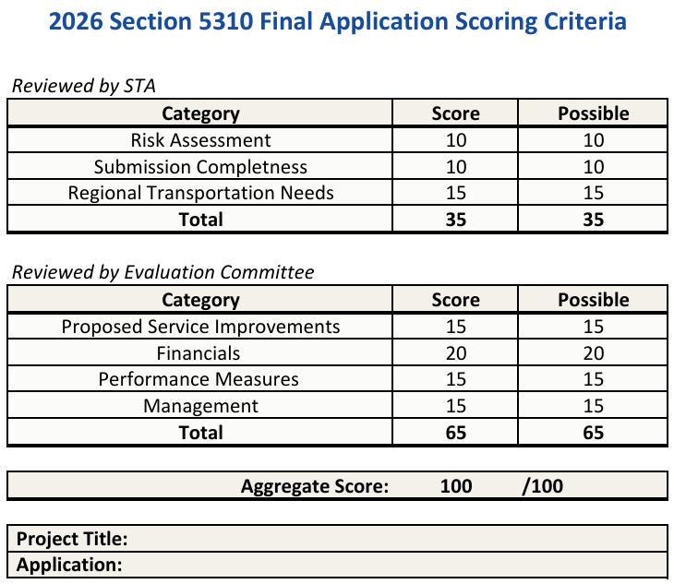
Project Scoring Criteria

Slide 17
Subrecipient Requirements
Active SAM.gov Registration
Quarterly Progress Reports
Monthly Beneficiary Reports
Accounting Records
Title VI Plan (Updated every 3 years)
Cost allocation plans must be submitted annually
Most recent audit
Backup documentation for all expenses operating projects seek reimbursement for
Annual monitoring reviews

Slide 18
Here to help!
Please schedule your preliminary meeting with Emilio Bustos, Assistant Transit Planner as soon as possible.
  Book a time to review your 5310 Application.
Additional technical assistance is available upon request

Slide 19
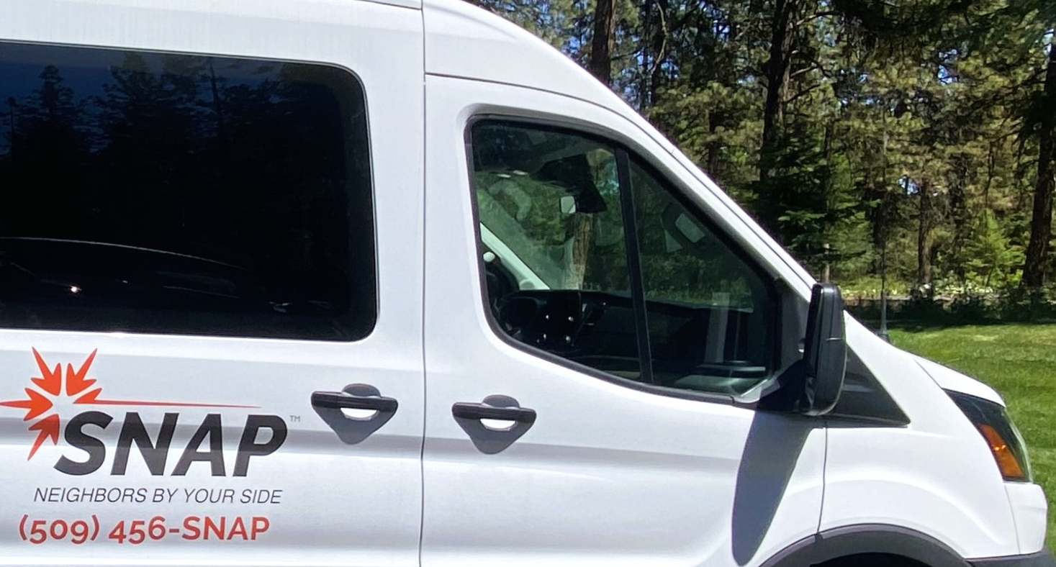
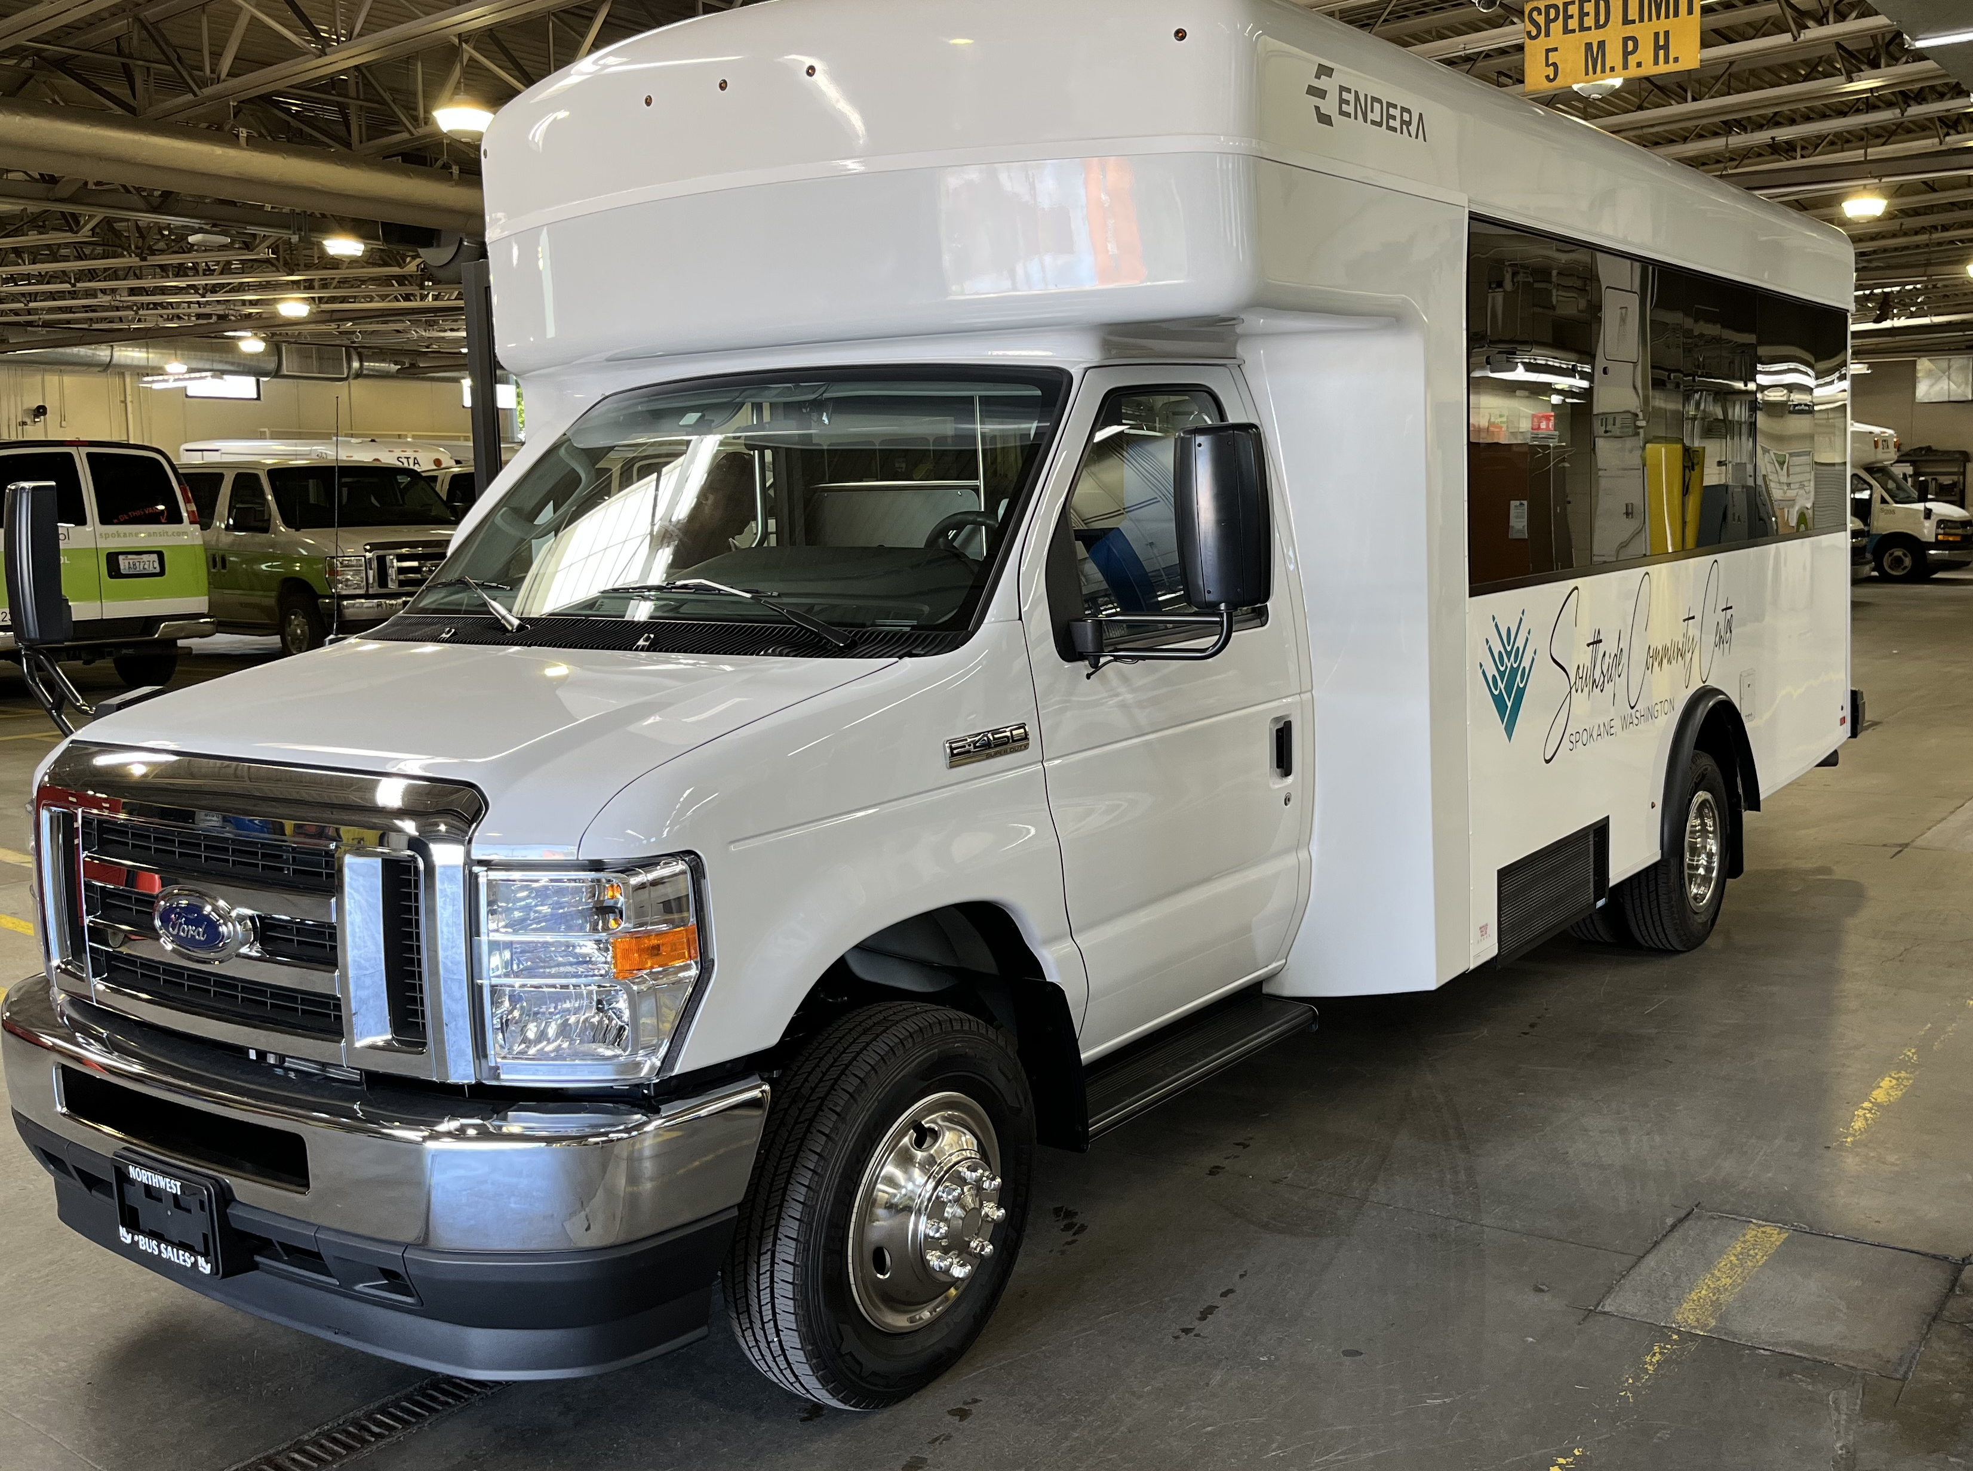
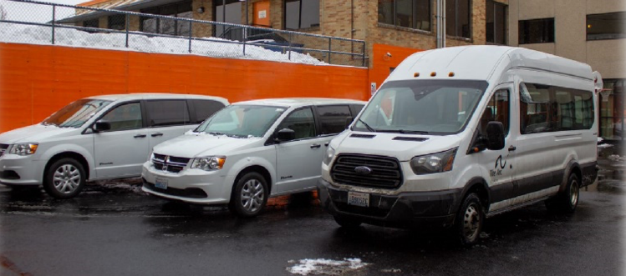
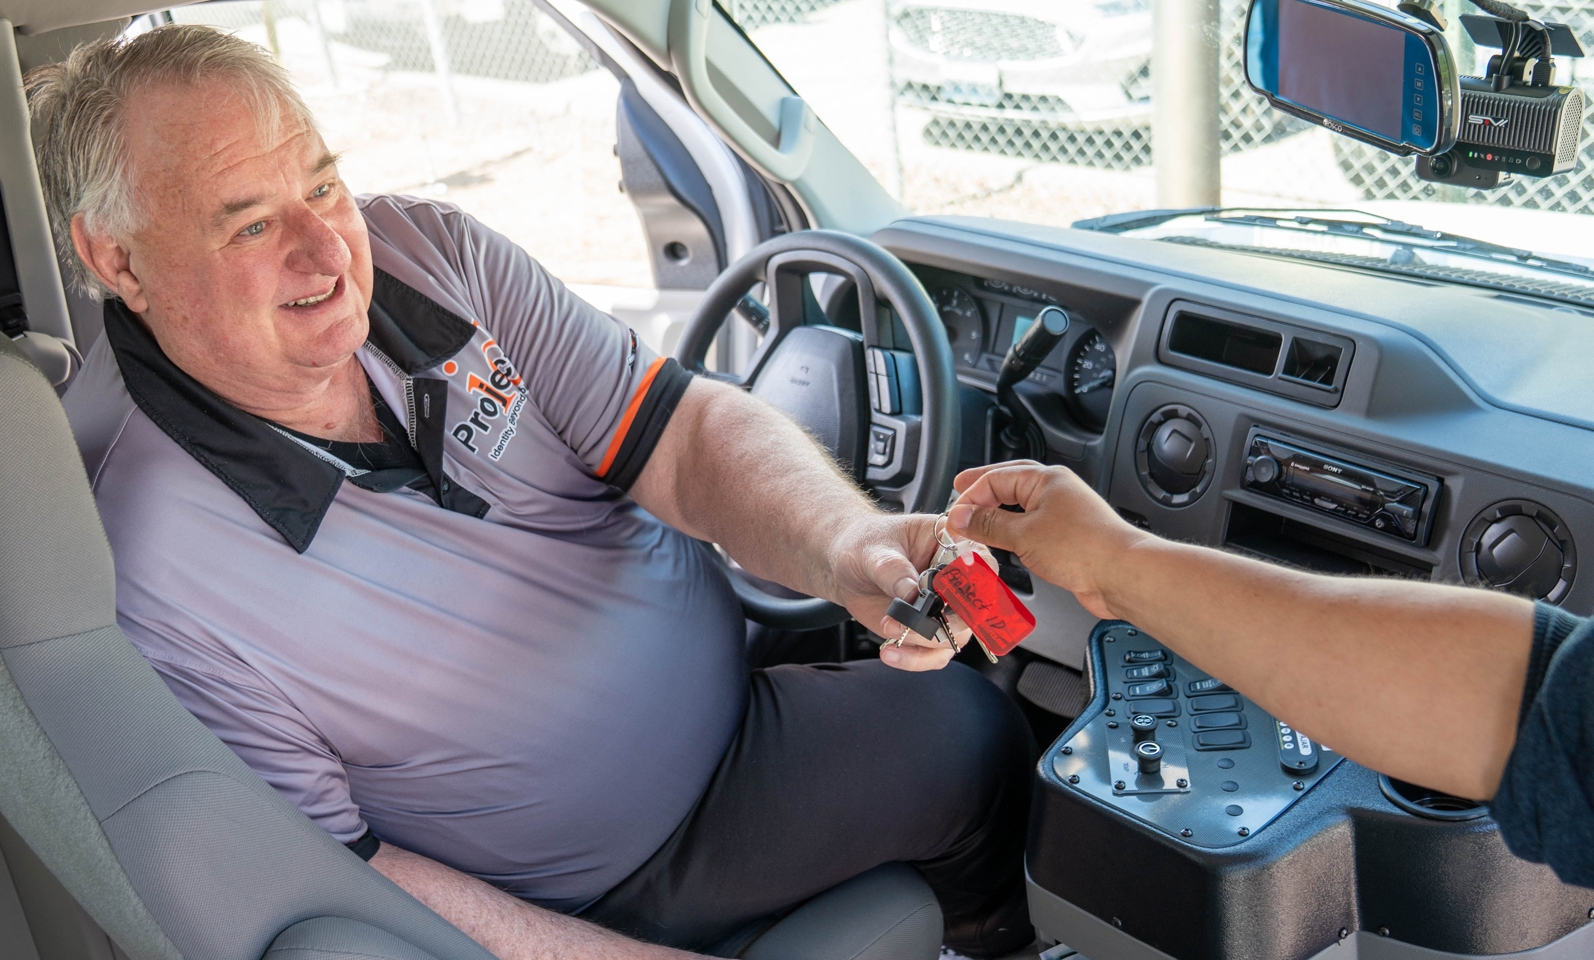
5310 Capital & Operating Projects Examples

Slide 20
Questions?
Presentation materials can be found on STA’s Section 5310 webpage at:
https://www.spokanetransit.com/about-sta/section-5310-program

Slide 21
Thank you!
Contact information:
Section5310@spokanetransit.com
Emilio Bustos, Associate Transit Planner
509.344.2609

